Slide 1
Fault Detection And Bit-Error Rate Diagnostics In Optical Wireless Links Using Edge-AI
Minor Project Final Defense Presentation
Sarthak Bhattarai (080BEI038)
Sheshadri Shikhar Bandyopadhyay (080BEI040)
Suprabh Dhakal (080BEI043)
IOE, Pulchowk Campus
August 2026

Slide 2
Introduction
Optical Wireless Communication (OWC) is a free-space optical approach to digital communication.
Our project implements an optical communication link for digital data transmission and recovery.
The system combines optical communication with embedded signal monitoring and machine learning.
The receiver integrates data recovery, signal analysis, and link-condition classification.

Slide 3
Problem Statement
OWC links are vulnerable to unpredictable environmental and physical disruptions.
Conventional diagnostics rely on external/cloud computing: higher latency, bandwidth usage, and reduced node autonomy.
Increasing RF congestion motivates alternative wireless communication technologies.
Need for a self-contained, embedded diagnostic system at the receiver.
Real-time evaluation of physical-layer parameters for:
Degradation severity
Degradation type
Local, infrastructure-independent diagnosis

Slide 4
Objectives
Implement a low-power OWC link for reliable digital data transmission and recovery.
Extract key diagnostic features: Signal Voltage, BER, SNR, and Ambient Light.
Train, quantize, and deploy a compact TensorFlow Lite Micro neural network on the receiver.
Classify four link conditions: Normal transmission, optical filter attenuation, ambient-light interference, and severe obstruction/misalignment.

Slide 5
Methodology
Experimental hardware-oriented approach: integrating optical communication, signal analysis, dataset generation, ML, and embedded inference.
FSO link development: laser-based transmitter → free-space LOS channel → photodiode receiver.
Receiver processing: transmitted data recovery and extraction of optical-link quality parameters.
Controlled optical conditions: systematic changes in the optical path/environment to generate labelled diagnostic datasets.
ML pipeline: labelled feature vectors → supervised classification → operating-condition diagnosis.
Final evaluation: communication performance and diagnostic accuracy, with the trained model deployed for embedded inference.

Slide 6
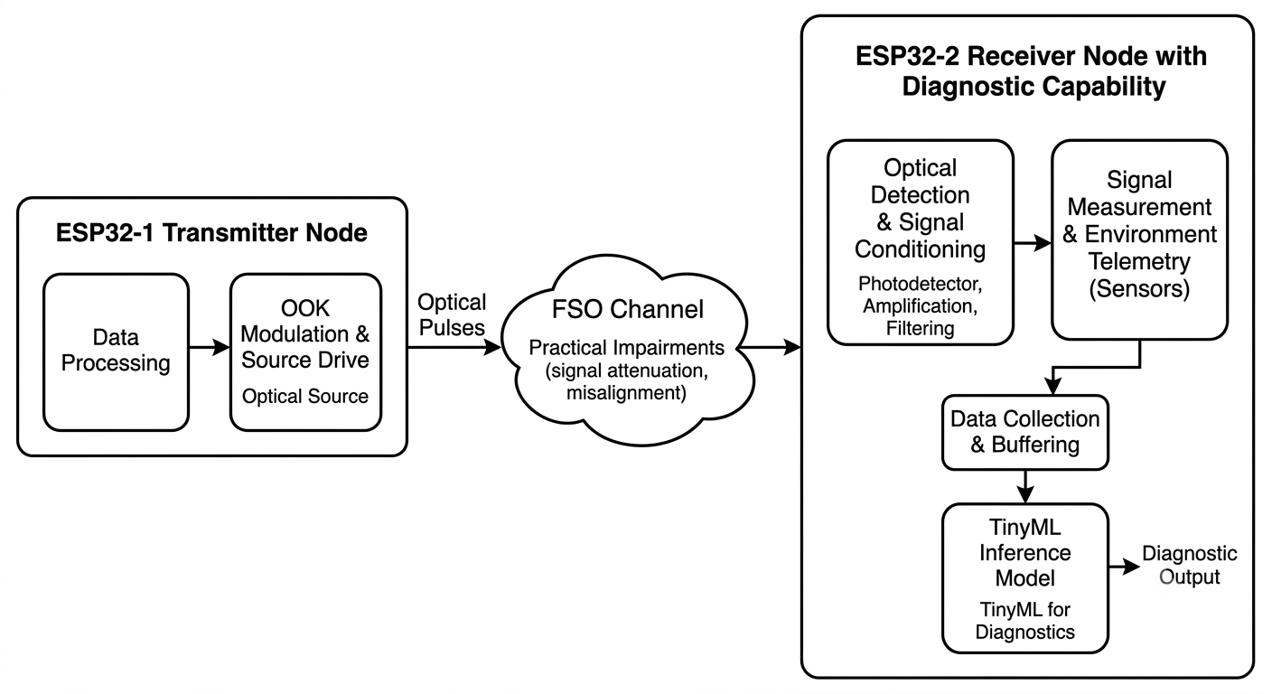
System Architecture

Slide 7
Algorithms/Models
Optical Transmission: Known binary payload transmitted using NRZ-L with synchronization and guard intervals.
Synchronization: Detects a predefined optical event to establish the start of payload sampling.
Bit Recovery: Multiple samples per bit interval with thresholding and majority voting for reliable bit decisions.
BER Calculation: Compares transmitted and recovered sequences to determine the bit error rate locally.
Telemetry & Feature Extraction: Extracts received voltage, BER, SNR, and ambient-light level into a diagnostic feature vector.
Classification: Supervised multiclass model classifies the link into four operating conditions.

Slide 8
Hardware Implementation
Separate ESP32-based transmitter and ESP32-S3-based receiver nodes.
Transmitter: 650 nm HW-493 laser, 2N2222 transistor switching stage, and 1 kΩ base resistor.
Receiver: BPW34 PIN photodiode, LM358 signal-conditioning circuit, and ESP32-S3 ADC acquisition.
Receiver performs optical signal detection, conditioning, communication analysis, feature extraction, and embedded classification.
ADC acquisition through ESP32-S3 GPIO 4.

Slide 9
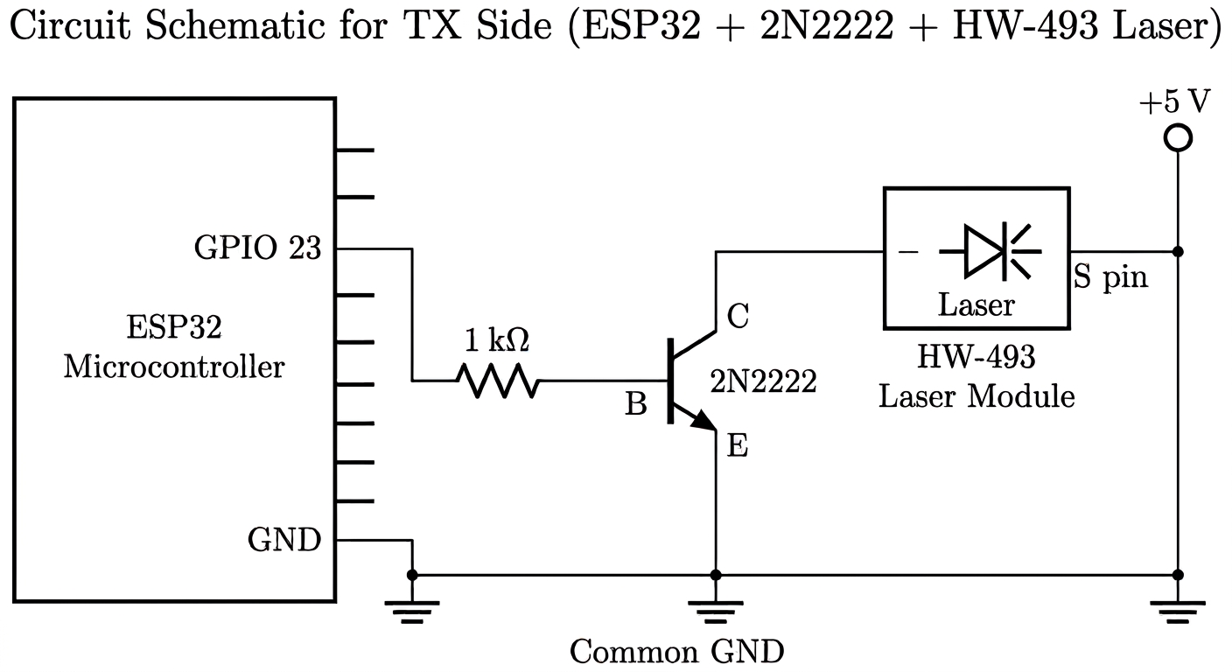

Slide 10
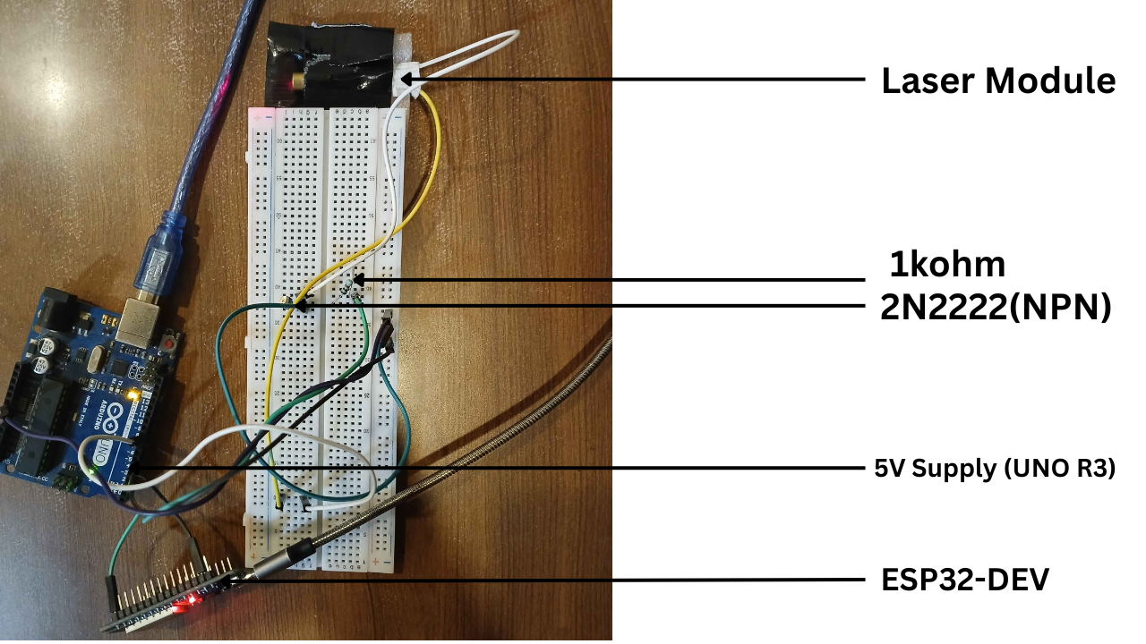
Transmitter Prototype

Slide 11
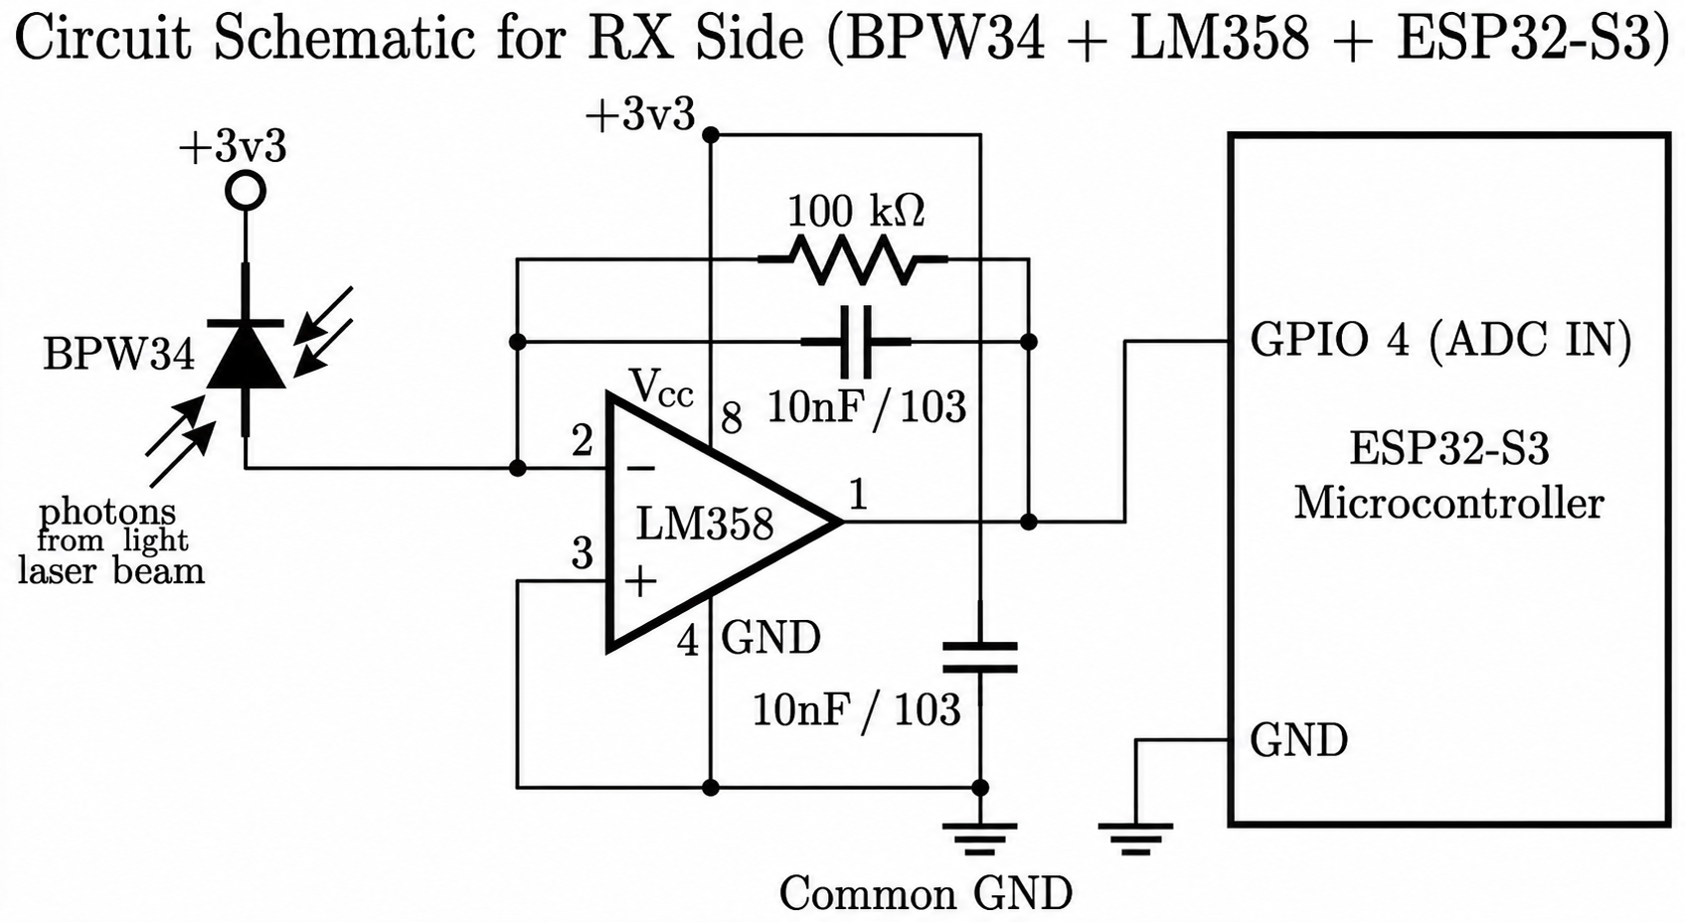

Slide 12
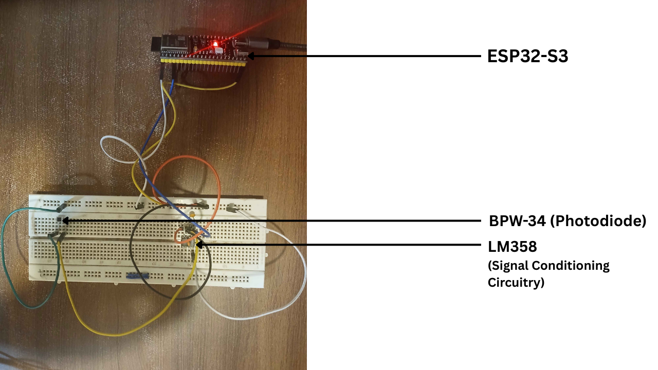
Receiver Prototype

Slide 13
Communication Firmware Implementation
1000 bit/s OOK with NRZ-L line coding and known fixed-text payload.
Transmitter: ESP32 GPIO 23 controls laser switching; 1 ms bit duration.
Receiver: ESP32-S3 GPIO 4 ADC performs signal acquisition, synchronization, bit recovery, BER calculation, feature extraction, and ML inference.
Synchronization: 100 ms pulse followed by 20 ms guard interval for deterministic payload timing.
Bit Recovery: Five ADC samples per bit across the central 60% of the bit interval, with a 1700-count threshold and majority voting.
All communication and diagnostic processing is performed locally on the receiver.

Slide 14
Dataset Preparation & Experimental Setup
Dataset generated directly from the developed OWC hardware to capture real system characteristics.
Known fixed payload transmitted under controlled operating conditions, with telemetry recorded and labelled by physical condition.
Diagnostic features: Signal Voltage, BER, SNR, and Ambient Light.
Four experimental classes:
Normal Condition (Class 0)
Optical Filter Attenuation (Class 1)
High Ambient Light (Class 2)
Severe Obstruction / Misalignment (Class 3)
Consistent measurement procedure maintained across all conditions for comparable data acquisition.

Slide 15
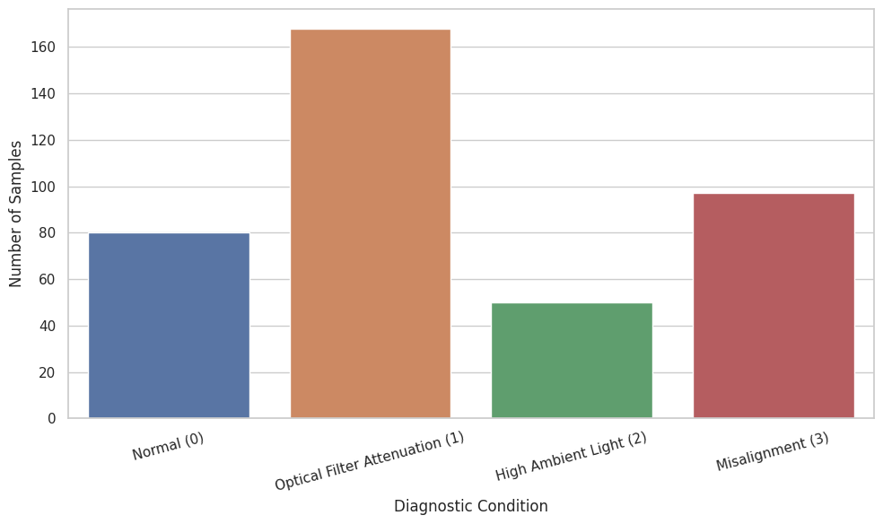

Slide 16
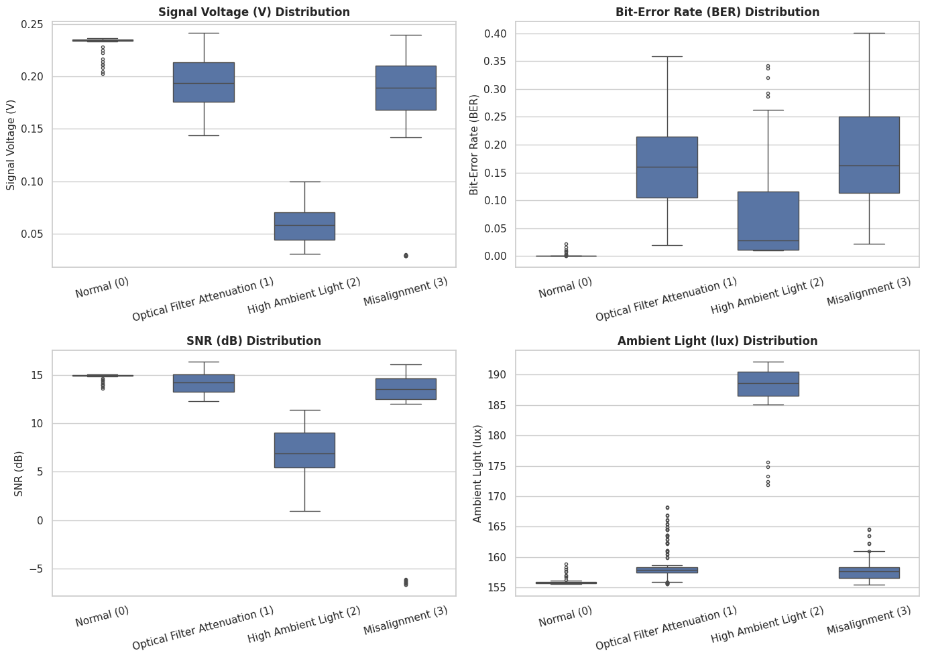

Slide 17
Machine-Learning Model & Edge-AI Deployment
Four-class supervised neural network using Signal Voltage, BER, SNR, and Ambient Light as inputs.
Compact TensorFlow Lite Micro model trained and evaluated using the prepared dataset.
Model converted and quantized to reduce memory and computational requirements for ESP32-S3 deployment.
TensorFlow Lite Micro integrated into receiver firmware for local inference without external computing.
Integrated operation: payload recovery → feature extraction → preprocessing → ML inference → diagnostic classification.

Slide 18
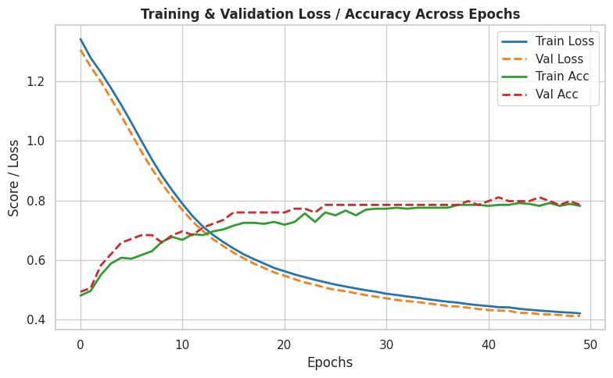

Slide 19
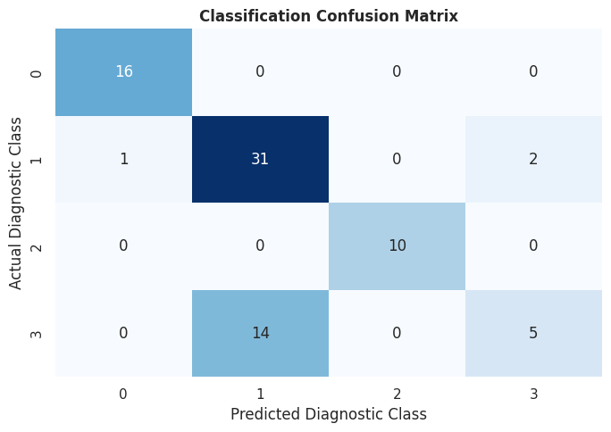

Slide 20
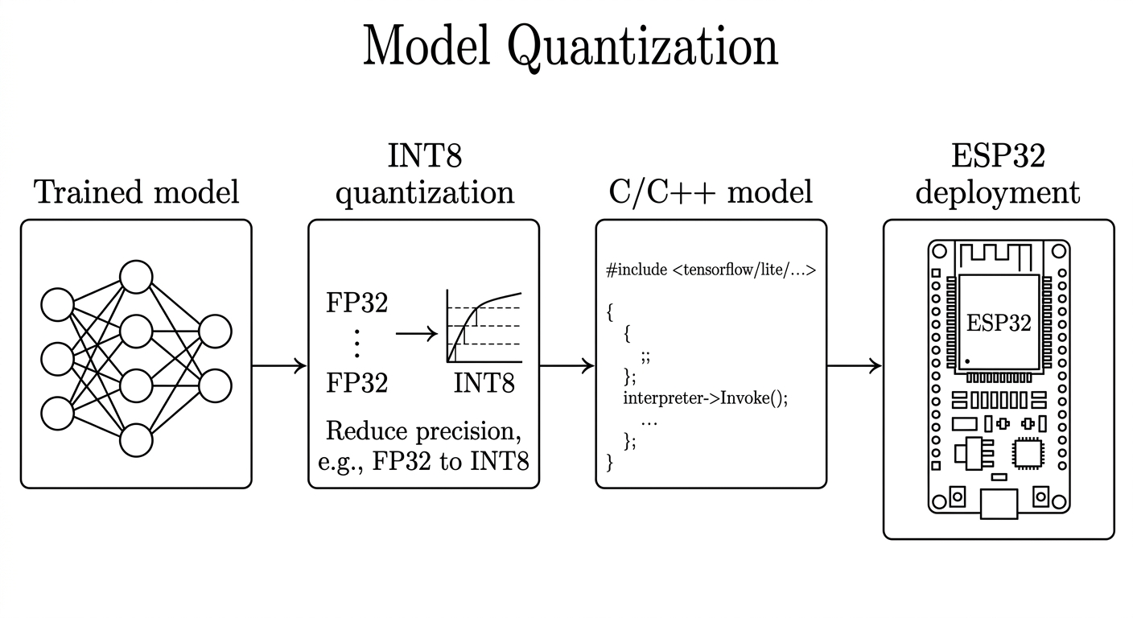

Slide 21
Results
Communication Performance
Normal LOS: BER = 0, signal voltage ≈ 0.12 V, SNR ≈ 10.5 dB.
Progressive degradation caused decreasing signal voltage/SNR and increasing BER.
Severe obstruction/misalignment: BER > 0.35 and SNR as low as −20 dB.
ML Classification Performance
Floating-point neural network: 78.48% test accuracy.
Random Forest: 77.22% test accuracy.
Quantized INT8 model: 74.68% accuracy with 3.32 kB memory footprint.
Best classification for normal and severe-obstruction conditions; greater confusion between filter attenuation and high ambient light.

Slide 22
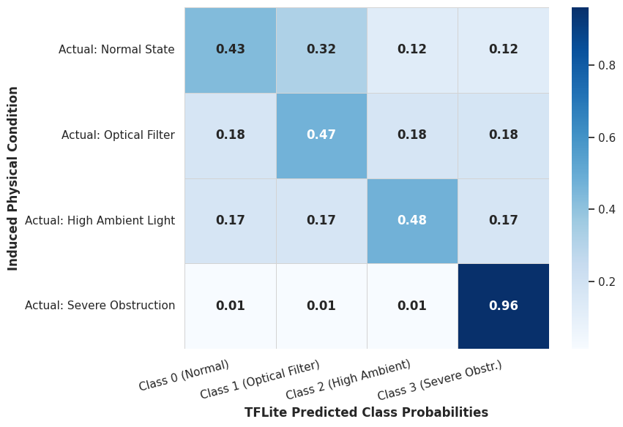
Results

Slide 23
Recommendations / Future Enhancements
Expand dataset diversity and size to improve model generalization.
Add complete-link-failure detection for loss of synchronization.
Investigate more bandwidth-efficient and error-resilient modulation/coding schemes.
Implement corrective mechanisms such as automated alignment and adaptive transmission power.
Expand diagnostic features with temporal/statistical signal characteristics to improve class separation.

Slide 24
THANK YOU !
IOE, Pulchowk Campus
August 2026

Slide 25
Conclusions
Autonomous point-to-point OWC testbed successfully integrated with Edge-AI diagnostics.
Receiver performs payload recovery, feature extraction, and link-condition classification using Signal Voltage, BER, SNR, and Ambient Light.
Four-class dataset developed from controlled hardware experiments.
Floating-point model achieved 78.48% test accuracy; quantized INT8 model occupied only 3.32 kB and was successfully deployed on ESP32-S3.
System demonstrated real-time, self-contained link diagnosis without external computation.

Slide 26
